Slide 1
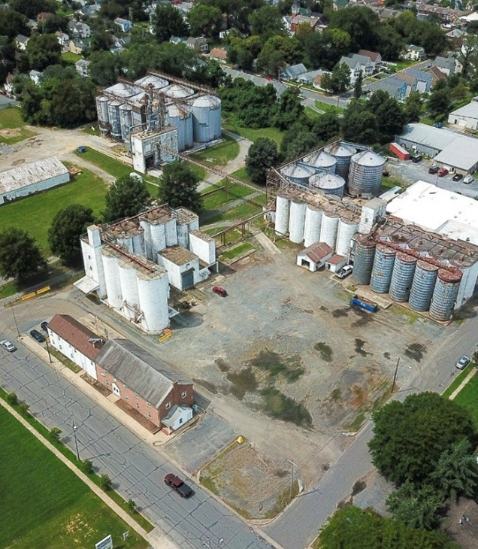
Easton Crossing
Initial Designs

Slide 2
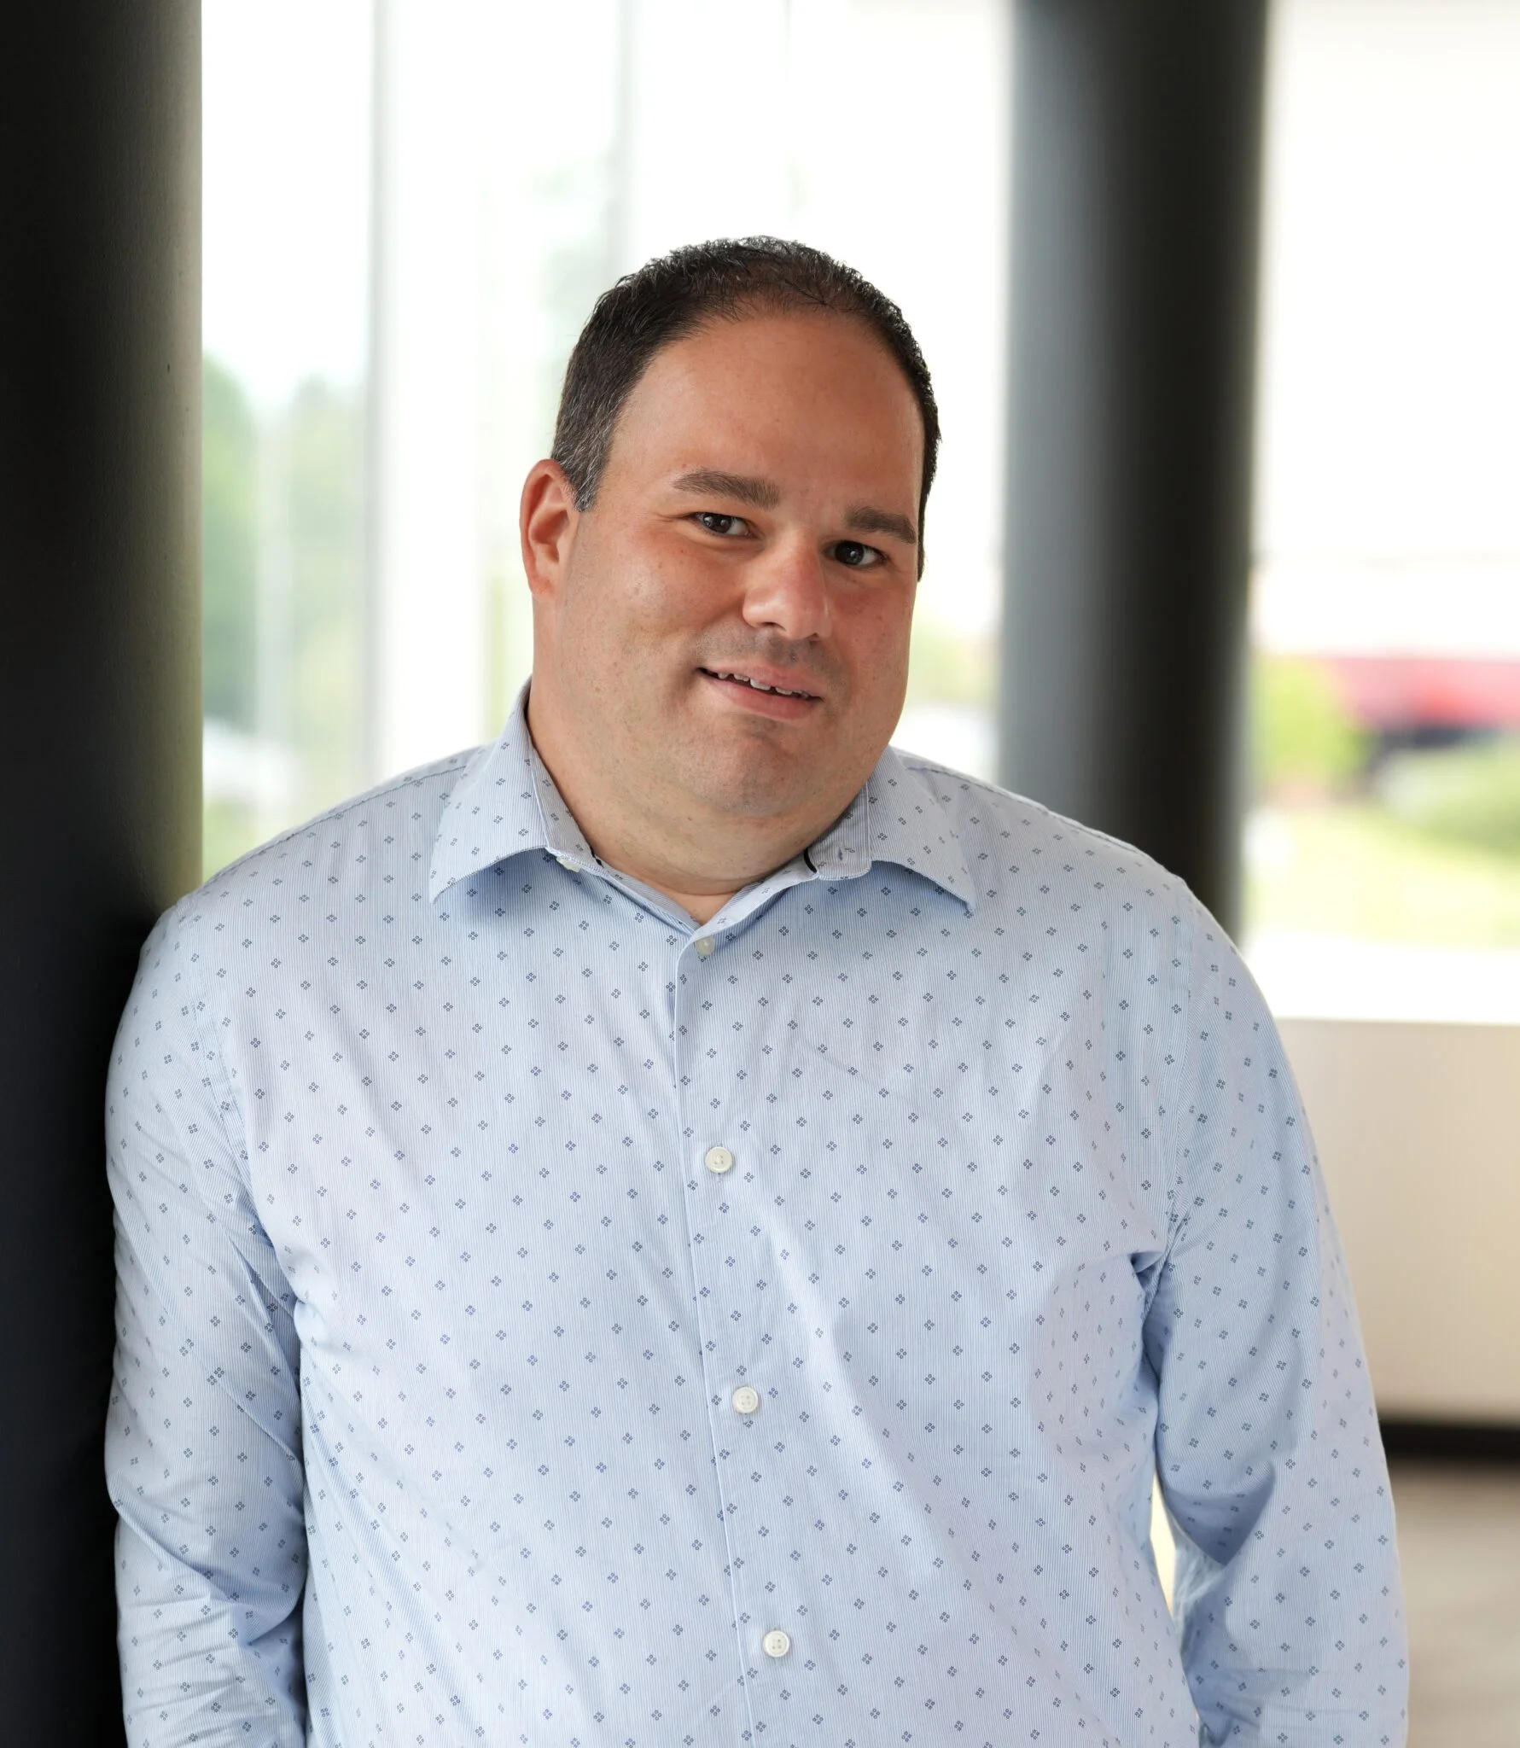
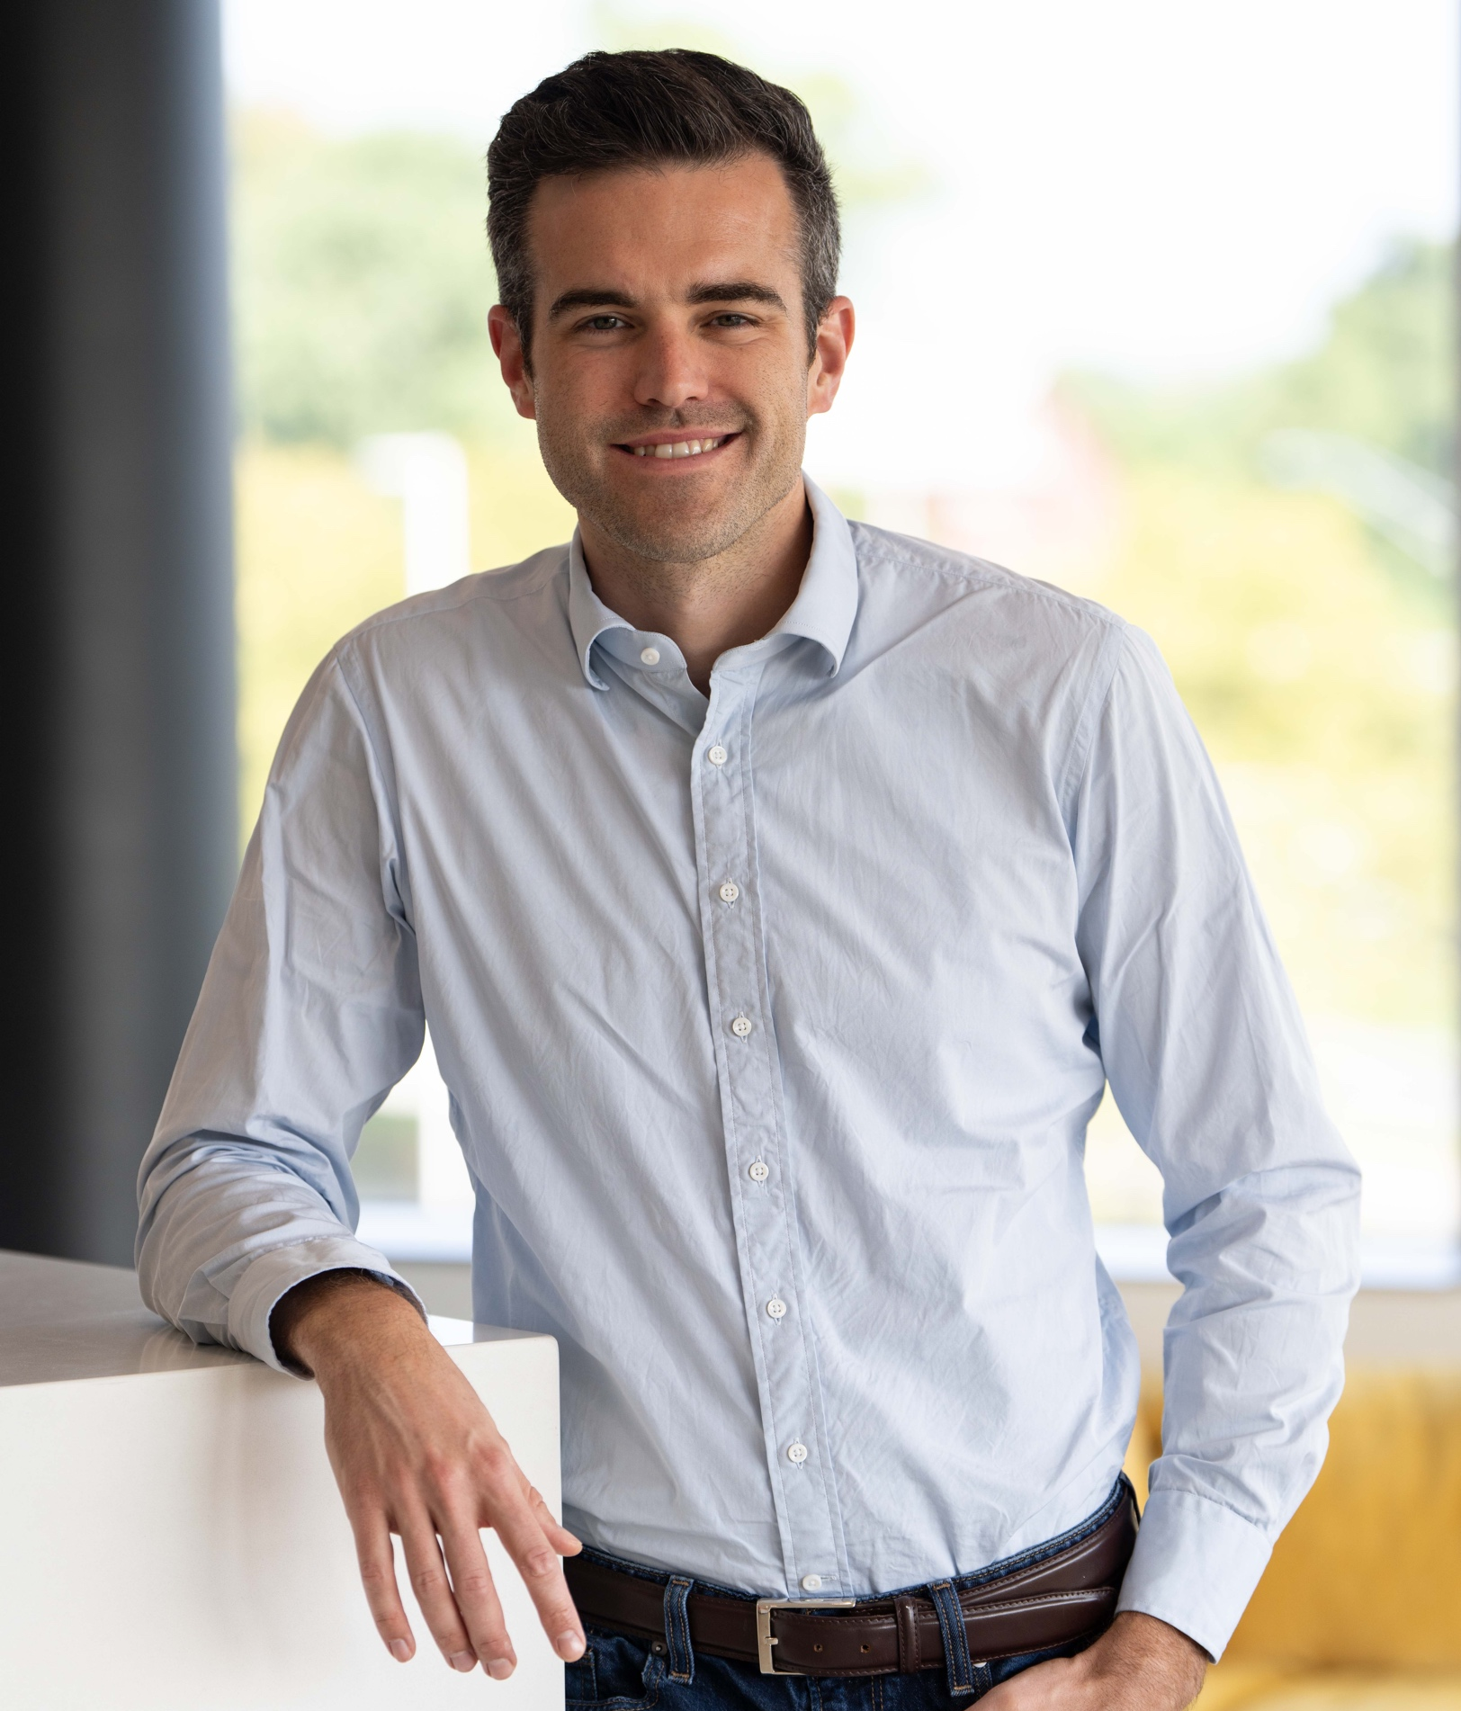
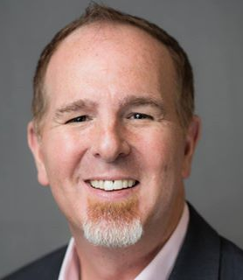
Welcome!
Jonathon Rondeau
President & CEO
The Arc Central Chesapeake Region
Ross Benincasa
VP of Community Development
Chesapeake Community Development
Chris Wheedleton
Consultant | Facilitator
Rivers & Roads
Notes:
WE want to welcome you all to this Community Conversation. When I say we, I mean… We also have representatives from RAUCH and BGC in the room.

Slide 3
What we’re going to do
Introductions
Community Feedback Thus Far
Draft Site Plans and Renderings
Small Group Work Sessions
Report Out
Action Planning – Next Steps
Notes:
CHRIS: Allow Chris to contribute to this slide

Slide 4
Who’s Here?
Lightning Round of Who’s at Your Table?
Before we go anywhere, we need to know who all is here
When I say go…
Huddle at your table to connect and make introductions where needed
After 5 minutes someone needs to do a quick highlight of who’s around the table to let the group know who’s here.
We are all here as Community members, so no need for anyone to get more that a sentence about them, no matter what they do – just name and role in the community.
Notes:
CHRIS: Allow Chris to contribute to this slide

Slide 5
About Chesapeake Community Development
Subsidiary of The Arc Central Chesapeake Region
Built around the need for equitable housing for all, we are focused on providing a mix of housing options, as well as community-oriented retail spaces.
We prioritize infill projects for better neighborhood cohesion and to reduce the effects of sprawl.
Notes:
JONATHON: Diving into who The Arc is and need for Chesapeake. Comm Dev.

Slide 6
Top 5 Conclusions From First Community Meeting
Diverse and Inclusive Community: There is a strong emphasis on creating a community that is diverse in terms of residents and businesses, with a focus on affordability, accessibility, and integration of different demographics (seniors, families, workforce).
Notes:
JONATHON: Diving into who The Arc is and need for Chesapeake. Comm Dev.

Slide 7
Top 5 Conclusions From First Community Meeting
2. Quality of Life and Amenities: Residents prioritize green spaces, native landscaping, safety measures (such as security cameras and adequate lighting), and accessible amenities like parks, playgrounds, and community gathering spaces.
Notes:
JONATHON: Diving into who The Arc is and need for Chesapeake. Comm Dev.

Slide 8
Top 5 Conclusions From First Community Meeting
3. Balanced Residential and Commercial Development: There's a consensus on the need for a balanced mix of residential units (including affordable and market-rate housing) and commercial spaces that avoid generic offerings and include local businesses and essential services.
Notes:
JONATHON: Diving into who The Arc is and need for Chesapeake. Comm Dev.

Slide 9
Top 5 Conclusions From First Community Meeting
4. Sustainability and Design Aesthetics: Concerns about environmental impact (stormwater management, green energy) and architectural coherence with the existing Easton style were prominent. There's also a desire for buildings to reflect local heritage and maintain aesthetic appeal.
Notes:
JONATHON: Diving into who The Arc is and need for Chesapeake. Comm Dev.

Slide 10
Top 5 Conclusions From First Community Meeting
5. Community Engagement and Transparency: Expectations include ongoing community engagement throughout the project, transparent decision-making, and proactive management of potential challenges such as traffic, parking, and noise.
Notes:
JONATHON: Diving into who The Arc is and need for Chesapeake. Comm Dev.

Slide 11
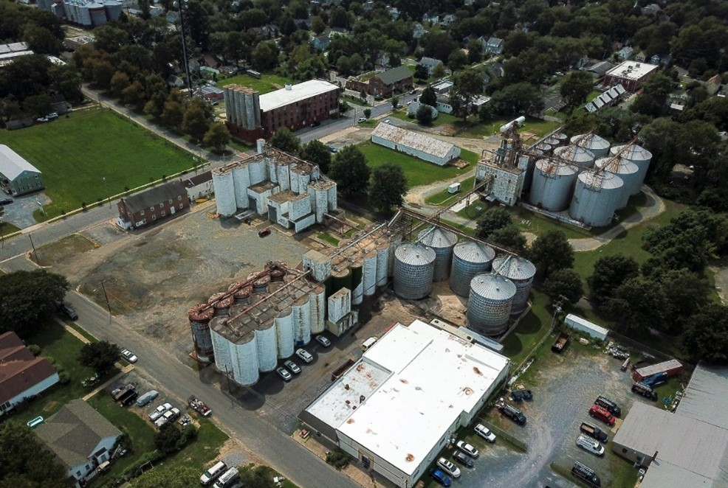
Lifestyle
Feedback

Slide 12
Lifestyle Items:
Affordability and Diversity: Strong desire for affordable housing that blends seamlessly with market-rate housing and for a variety of residents

Slide 13
Affordability & Diversity
Chesapeake Community Development will be setting aside on average 30% of all units for a variety of affordability levels.
These will NOT be specific units on the campus, avoiding any risk of differentiation in the way the units are built or designed based on tenancy.

Slide 14
Lifestyle Items:
Safety and Security: Attendees noted an importance to make sure the infrastructure is in place to make visitors and residents feel safe on the property.

Slide 15
Safety
The entire campus (interior and exterior) will be monitored via camera.
We are currently working with landscape designers to ensure all areas of the campus are lit in a fashion that promotes safety without disturbing nearby properties.

Slide 16
Safety
Easton Crossing will have on-site staff provided by Chesapeake Community Development, and we are working with the Town and EPD to ensure we are set up for safe public access from Day 1.

Slide 17
Lifestyle Items:
Traffic and Noise: Attendees desired for pre-emptive considerations to traffic, especially around side streets, and noise pollution in the area.

Slide 18
Traffic
Based on feedback from residents, we are engaging a traffic study for the property and adjacent streets
We are orienting all transient traffic from Brookletts, to avoid visitors using the smaller side streets.

Slide 19
Lifestyle Items:
Commercial Tenancy: A desire for local businesses instead of chains. Some concerns expressed around vacancy if a business fails, and catering to the residents by being open outside of standard office hours.

Slide 20
Commercial Tenancy
Based on community feedback, we will specifically be focusing on local entrepreneurs and small businesses ready to grow or relocate, without negatively affecting other areas of town.

Slide 21
Commercial Tenancy
We imagine spaces ranging from 1,000-3,500 sf, allowing for multiple small businesses serving the community, and avoiding significant vacancy during a single turnover.

Slide 22
Commercial Tenancy
We do not see a grocery store coming in as a tenant. Their parking requirements would dominate the site, and we are fearful of negatively affecting the Central American markets on nearby blocks.

Slide 23
Construction
Feedback

Slide 24
What Did We Hear?
Building aesthetics that combine Easton brick with industrial past
Integration with Rail Trail
Balanced parking solutions that don’t dominate the view of the development
Adequate public/green spaces and accessibility
Environmental and Infrastructural Sustainability

Slide 25
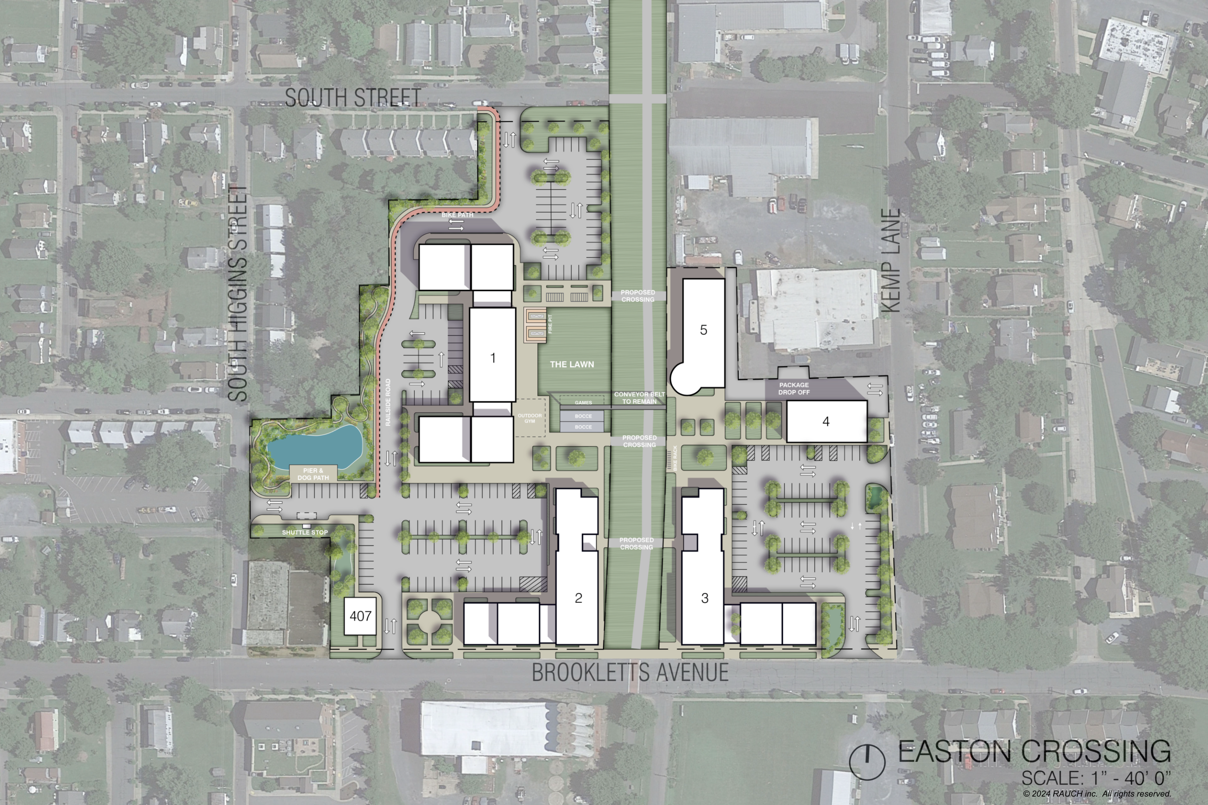

Slide 26
Phase 1
2027-2028

Slide 27
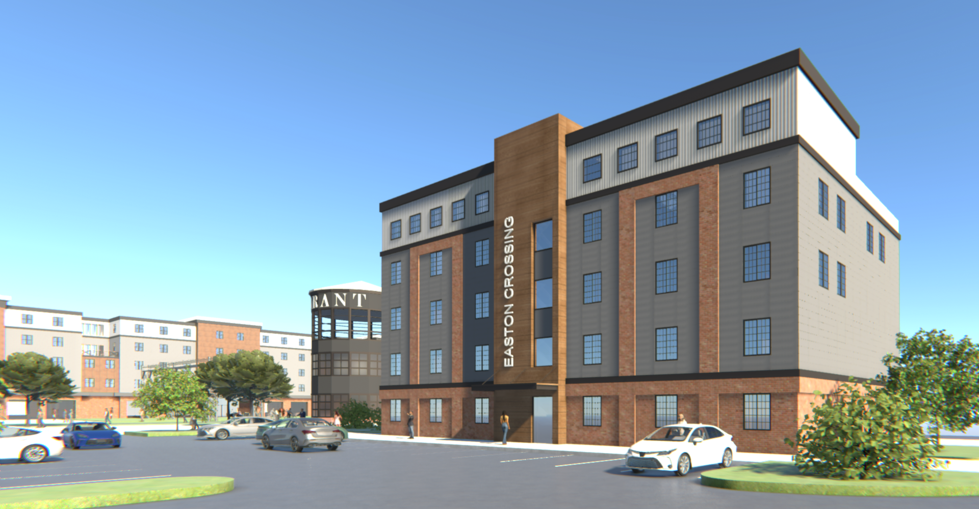

Slide 28
Phase 2
2029

Slide 29
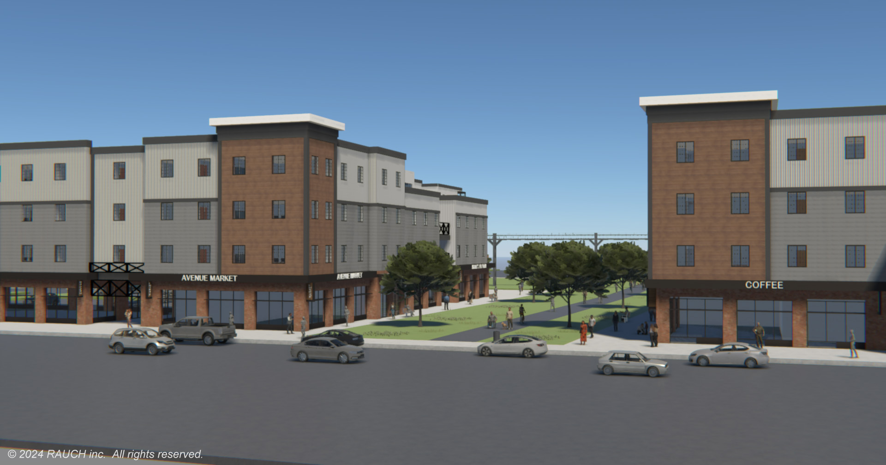

Slide 30
Phase 3
2030

Slide 31
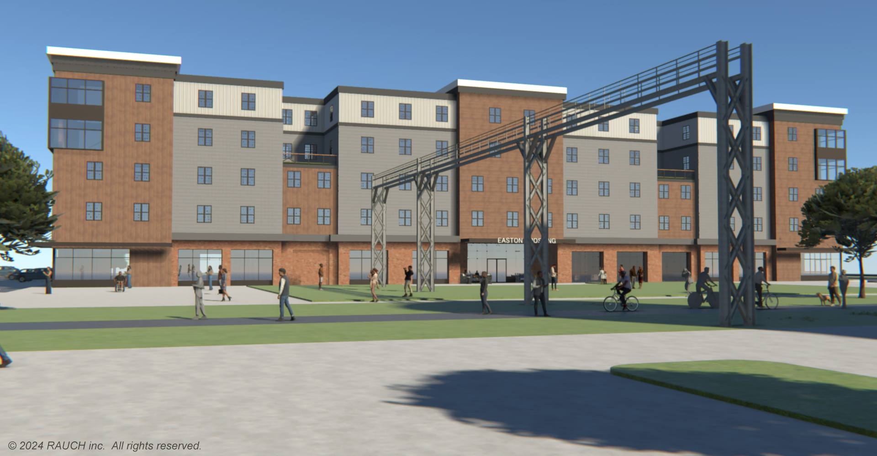

Slide 32
Leasing Office
June 2025

Slide 33
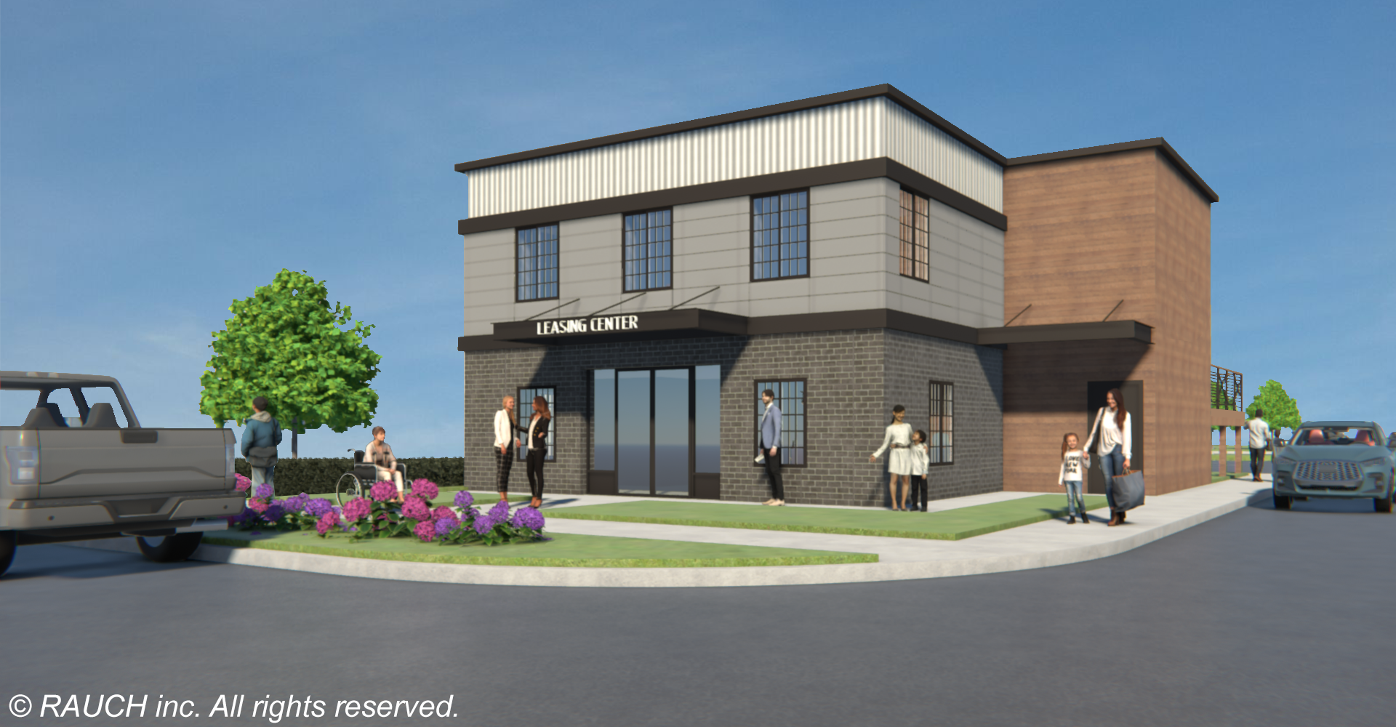

Slide 34
Restaurant
Event Venue
2030+

Slide 35
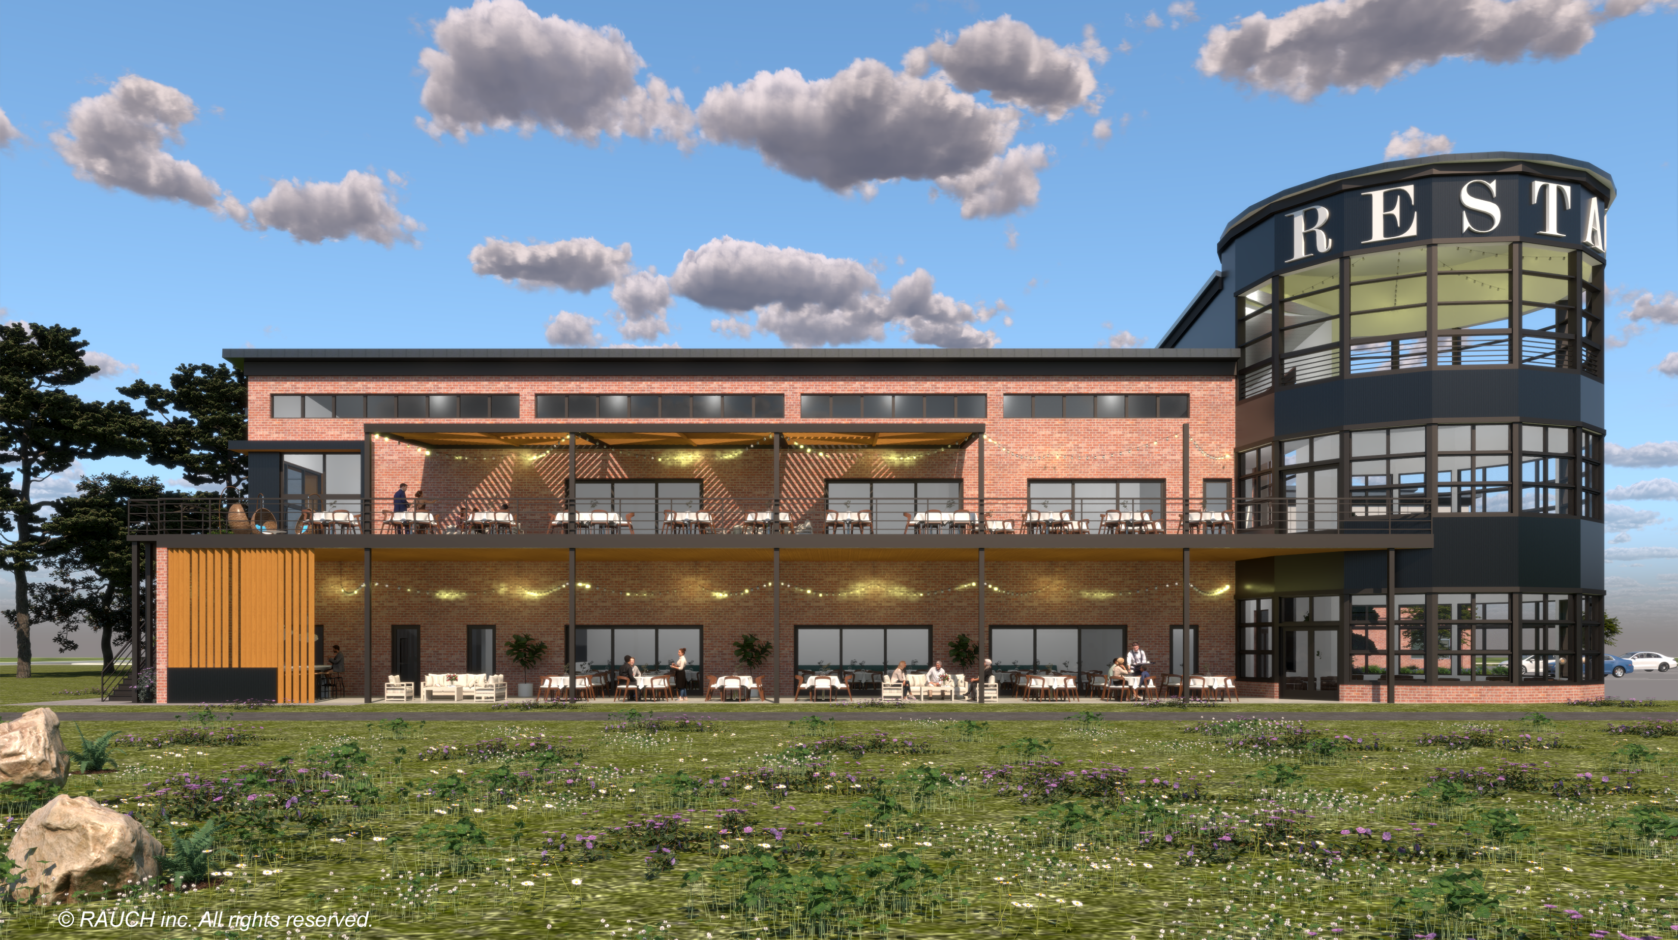

Slide 36
Grounds
Phased

Slide 37
Integration
with
Rail Trail

Slide 40
Balanced
Parking
Solutions

Slide 41
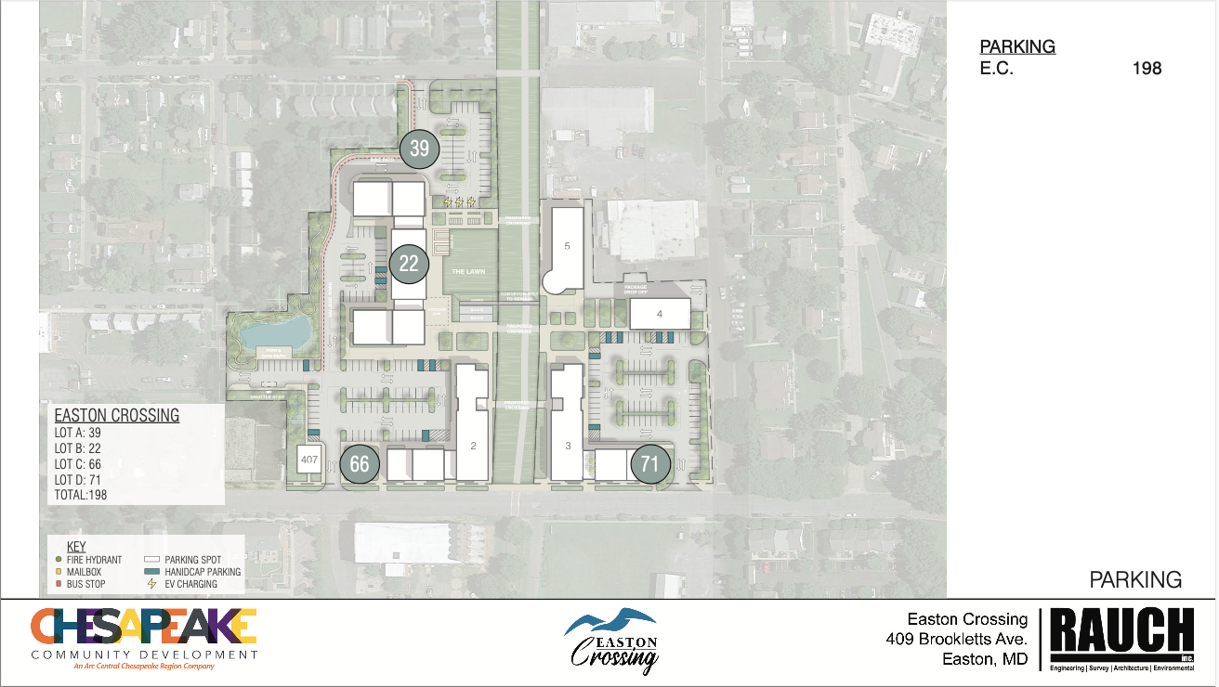

Slide 42
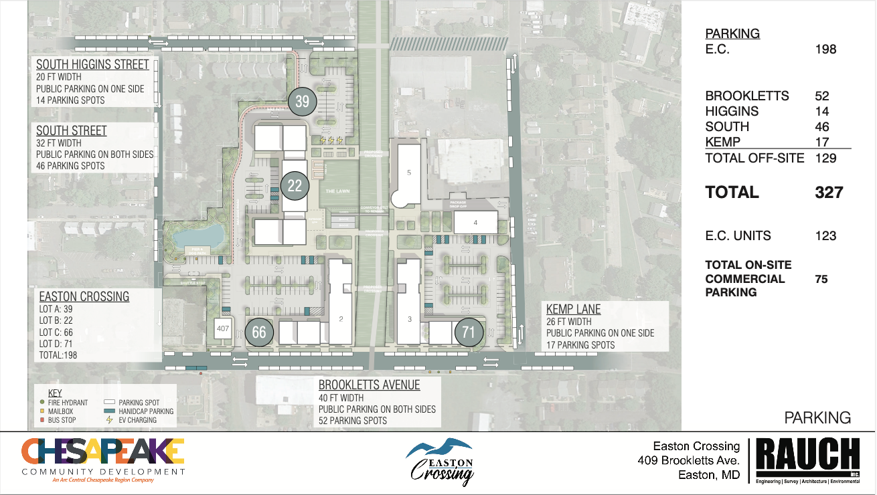

Slide 43
Parking – What We Can’t Do
Some attendees requested an underparked campus, focusing heavily on pedestrian accessibility.
The reality is that we do need to provide parking for all residents, as to not negatively impact the public streets and neighborhood.

Slide 44
Public
Green
Spaces

Slide 46
Environmental
Infrastructure
Sustainability

Slide 47
Sustainability
Most buildings that Chesapeake Community Development builds ground-up are built to LEED standards
In our conversations with Easton Utilities, we do not see any infrastructure upgrades needed coming into or out of the site.

